Slide 1


Data Analysis and Visualization for Social Buzz

Slide 2


Today's agenda
Project recap
Problem
The Analytics team
Process
Insights
Summary

Slide 3

About Social Buzz
Social Buzz is a Social media & content creation industry founded by two former engineers in 2010. Social Buzz has experienced rapid growth over the past 5 years, reaching 500 million monthly active users and over 100,000 pieces of content (text, images, videos, GIFs) posted daily. So, We’re starting with a 3-month project to prove our expertise by:
An audit of their big data practice
Recommendations for a successful IPO
An analysis of their content categories that highlight the top 5 categories with the largest aggregate popularity
Project Recap

Slide 4

Problem
Over 500 million active users monthly create a massive amount of unstructured data.
Over 100,000 Pieces of content posted daily
Now, Understand which content categories drive the most engagement and Identify top-performing content categories to inform content strategy.
We need to
Analyze their content categories and highlight the top 5 with the largest aggregate popularity.

Slide 5



ANDREW FLEMING
Chief Technology Architect
The Analytics team
MARCUS ROMPTON
Senior Principal
Goli Srimannarayana
Data Analyst

Slide 6
Process
1
Data Understanding
2
Data Cleaning
3
Data Modelling
4
Data Analysis
5
Uncover Insights

Slide 7

Insights
16
1897
January
Reactions to
Animals post
Months with more posts
Unique categories

Slide 8
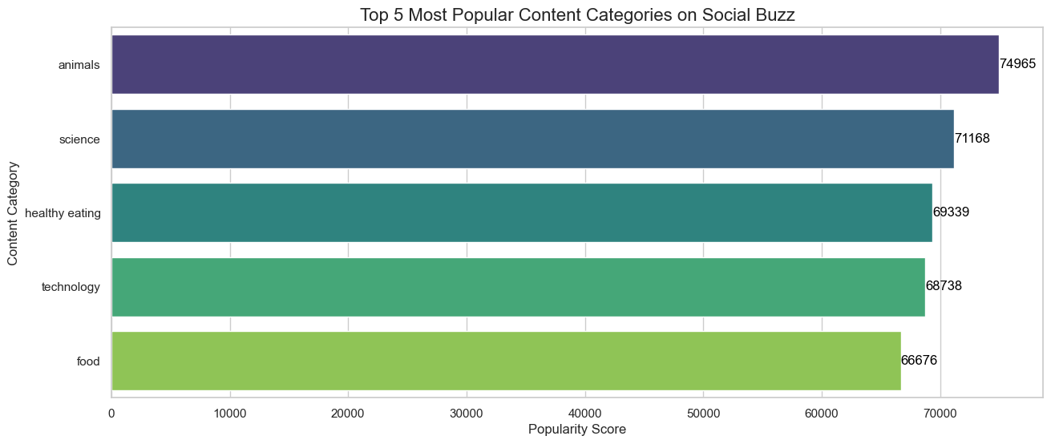
Top 5 Content Categories
Animals: 74,965
Science: 71,168
HealthyEating: 69,339 Technology: 68,738
Food: 66,676

Slide 9
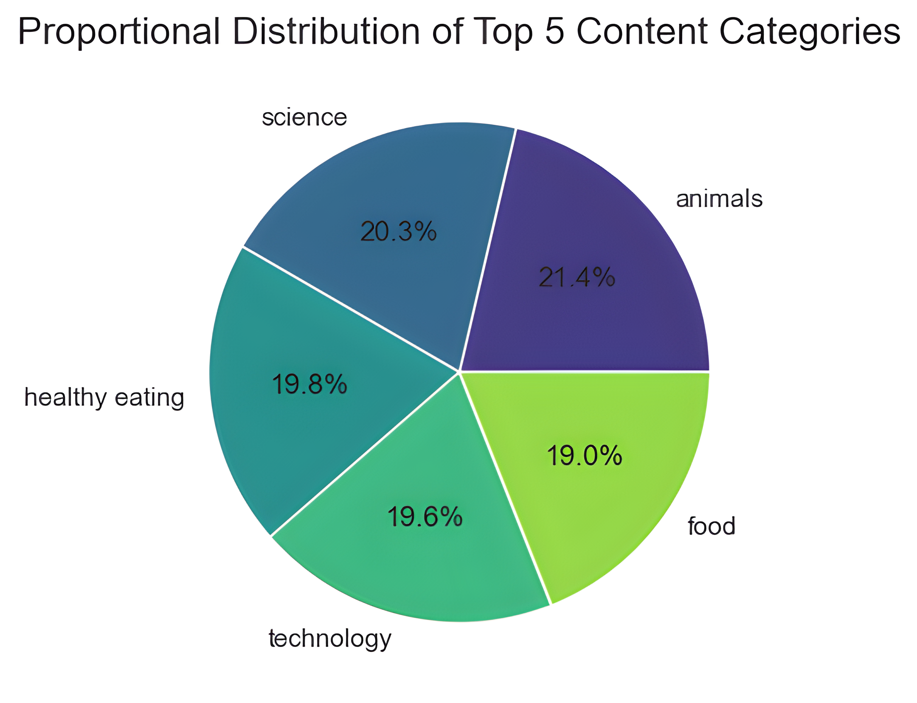

Slide 10

The data indicates that "animals" is the most popular content category. "Science" and "healthy eating" are also quite popular. Each of the top categories has a variety of sub-topics within it.
Popular categories resonate well with the Social Buzz audience. Animals" and "science" have a slight edge over other categories. Having a variety of content allows for reaching different audience groups.
Summary
Analyze the performance of sub-topics within each top category. Research your audience to understand their preferences and motivations. Create a content strategy that prioritizes the top categories and identifies niche opportunities.

Slide 11
Thank you!
ANY QUESTIONS?

